Slide 1
Sprint Review – Team A

Slide 2
Goals of Sprint Review/Retro
Review: Demo each “story” (task/requirement) to product owner for acceptance
Retro: reflect on sprint, suggest changes for process improvement

Slide 3
Problem Significance
Task: estimate the circumference and area of a circle without using Pi
Goals:
Accomplish task
Familiarize ourselves with GitHub and agile principles
Improve software development skills

Slide 4
Algorithm – summarize main functions called and why

Slide 5
Algorithm – explain in plain English why numerical methods are used

Slide 6
Algorithm – explain in plain English how you would extend the algorithm to 3D, 4D, beyond

Slide 7
Coding – do a study on how changing input parameters in the algorithms changes the outputs?

Slide 8
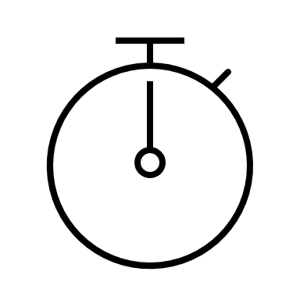

Function timers
Use of timer Python library to determine run time of each function
Example of timer encapsulating circumference function
tic_circ = time.perf_counter()
estimate_circ(r,n,choice)
toc_circ = time.perf_counter()
t_calc = (toc_circ - tic_circ) * 10 ** 6
print(f "Circumference approximated in {t_calc:0.4f} microseconds")
Timer started
Function call to circumference estimation
Timer ended
Timer Start – Finish (in microseconds)
Print statement
Same code used to encapsulate area estimation function

Slide 9
Coding – using any kind of data outputted from this exercise show a cool plot with colors

Slide 10
Explain in plain English a GE scenario that would benefit from numerical integration

